Slide 1
The Craft of Research
Ch11

Slide 2
Team Members
指導教授:郭育仁
組員:
M016070012-蘇文呈
M016070011-吳孟珊
M016070026-陳苾鈐
M016070003-蔡念倢

Slide 3
warrants

Slide 4
summary
1.what is warrants?
2.how warrants work?
3.how to test warrants?
4.when and when not to state them?

Slide 5
1.what is warrants?
show a reason is relevant to the claim, it is supposed to support

Slide 6
the connection between your claim and reason must show,
or some argument may appear,
warrant is a statement that connects a reason to a claim

Slide 7
1.1
warrants in everyday reasoning
1.2
warrants in academic argument
1.3
understanding the logic of warrants

Slide 8
2.how warrants work?
warrant is hard to grasp and difficult for beginners
the raesons are:
first, advanced researches rarely state warrants, assume their readers know them(especially spcific field)
second, some warrants don't explicitly dis tinguish a circumstance from its predictable consequence

Slide 9
THINK
understand them easily enough when someone offers a proverb to justify his reason,
warrant is academic proverb and more difficult to manage

Slide 10
LOGIC
This General Circumstance implies This General Consequence
When a nation’s labor force shrinks. Its economic future is grim.
[cause] [effect]
[reason] [claim]
Russia’s birthrate is only 1.17 and men’s it faces a falling standard of living.
Life expectancy has dropped to 58.
warrant consists of a general circumstance and a general consequence
This Specific Circumstance lets us infer This Specific Consequence
Effect→Claim→Reason→Cause

Slide 11
1.4 Testing whether a warrant is reliable
Is your warrant basically true?
Is your warrant prudently limited?
Can your warrant be trumped?
Is your warrant appropriate to your readers' community?
Is your reason and claim good instance of the general warrant?

Slide 12
1.5 Knowing when to state a warrant
Your readers are outside your field
You use a principle of reasoning that is new or controversial in your field
You make a claim that readers will resist because they just don’t want it to be true.

Slide 13
11.6 challenging others’ warrants
experience
challenge the reliability of the experience
fund counterexamples that cannot be dismissed as special cases
authority
use evidence or reaches beyond its expertise.
argue the source is in fact not an authority at all.
systems of knowledge
Challenge “facts” are difficult
What kind of situation doesn’t fix the warrant

Slide 14
11.6 challenging others’ warrants
cultural
“common sense.”
Methodological
“meta- warrants,”
Explain abstract reasoning
Articles of Faith
It is pointless to challenge, cuz the warrant statements of faith
readers will resist, because you seem to challenge their heritage.
ignore them not as a subject for research but as an inquiry into the meaning of life.
generalization
analogy
sign

Slide 15

Q&A
1. When your readers doubt your warrant , how can you do counterexamples

Slide 16

2. Which warrant do you want to challenge? Why?

Slide 17

3. Have you ever doubt others warrants ?

Slide 18
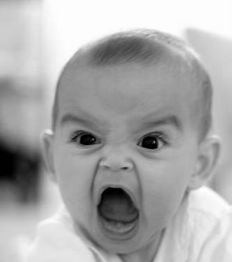
The end
Thank you for your listening ☺

