Slide 1
Chapter 7 Sampling
Presenter：Su Chen Wen
Jian Xiao Yu

Slide 2
Contents
Introduce
Population or Sample ?
The Basics of Sampling
Types of Samples
A series of samples
何謂推論統計
抽樣分配
信賴水準
如何減少隨機抽樣誤差

Slide 3
Introduce
In this and the next three chapter we address the task of making the empirical observations with which to implement research design and text hypotheses.
This is called the data collection stage of a research project.
Whatever the hypothesis under consideration, researchers must decide what observations are appropriate for testing.

Slide 4
In many cases researchers choose to collect data on only some of the pertinent observations instead of measuring or observing all of the possible observations covered by a hypothesis.
  A population is any well-defined set of units of analysis.
  A sample, by contrast, is any subset of units collected in some manner from the population.
In the remainder of this chapter we discuss the differences between populations and samples and the ways in which a sample may be drawn from a specified population.

Slide 5
Population or Sample ?
A researcher’s decision whether to collect data for a population or for a sample is usually made on practical grounds.
  Time , Money, Other costs
Thus for reasons of necessity and convenience, political science researchers often collect data on a sample of observations.

Slide 6
The Basics of Sampling
In the sample is selected properly, the information it yields may be used to make inferences about the whole population.
  population parameter
  Estimator
  Sample statistic
  Element
  Stratum
  Sampling frame
  Random digit dialing
  Sampling unit

Slide 7
Types of Samples
A probability sample is simply a sample for which each element in the total population has a known probability of being included in the sample.
A nonprobability sample is one in which each element in the population has an unknown probability of being selected.

Slide 8
A series of samples
Sample Random samples, each element and combination of elements have a equal chance of being selected.
Systematic sample, in which elements are selected from a list at predetermined intervals, provides an alternative method that is sometimes easier to apply.
Stratified samples, is probability in which elements sharing one or more characteristics are grouped, and elements are selected from each group in proportion to the group’s representation in the total population.

Slide 9
Cluster Samples, is probability sample in which the sampling frame initially consists of clusters of elements.
A nonprobability sample is a sample for which each element in the total population has an unknown probability of being selected.
A probability samples are usually preferable to nonprobability samples because they represent fairly accurately a large population, and it’s possible to calculate how close an estimated characteristic is to the population value.

Slide 10
統計推論
母體 抽樣 樣本
推論
母數
樣本統計量

Slide 11
抽樣分配(Sampling Distribution)
由同一母群體做同樣方式重複的抽取同樣大小之樣本後所得到的次數分配。
EX：我們想要了解台灣地區女性朋友使用防曬油的頻率？
假設台灣女性人口為全國總數的一千一百萬人。（母體）
（參數：防曬油使用次數）

Slide 12
抽樣分配例子
在全台灣隨機抽樣五百名女性為樣本調查使用防曬油頻率(樣本)，進而推論台灣女性人口總數一千一百萬人(母體)可能的結果。

Slide 13
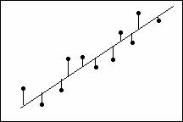
信賴水準(Confidence Level)
以樣本推論母體時，正確估計的可能性有多少？即估計正確的機率數值大小是為信心水準。

Slide 14
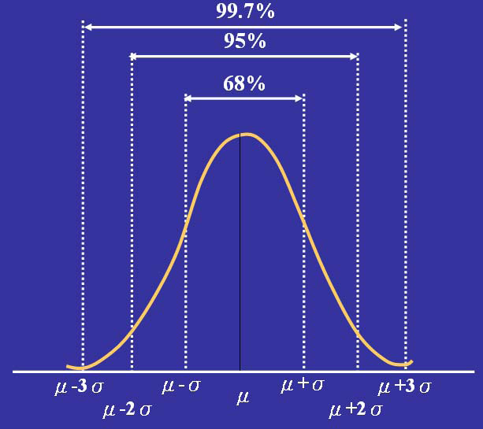
信賴區間

Slide 15
信賴區間例題
某校有學生1000 位，數學段考成績呈常態分配，平均成績70 分，標準差10 分，
則
  (1)此次段考成績不及格的學生約有幾位？
  (2)成績超過90 分的有幾位？
  (3)某生成績80 分，他在全校大約排第幾名？

Slide 16
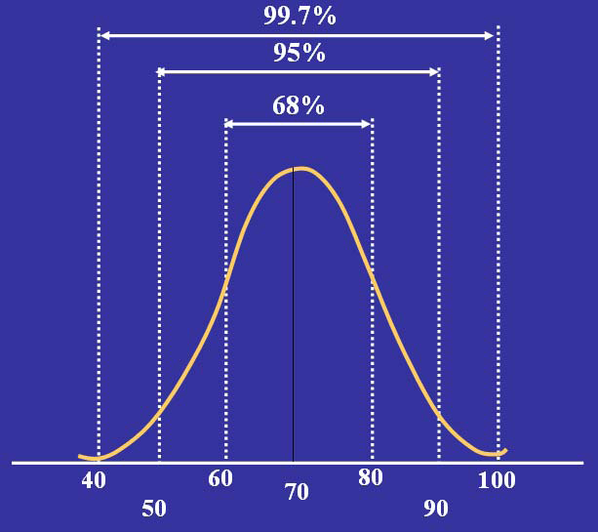
Answer
  (1)此次段考成績不及格的學生約有幾位？
1000 X32%/2= 160 (人)

Slide 17
Answer
  (2)成績超過90 分的有幾位？
  1000x5%/2=25(人)

Slide 18
Answer
  (3)某生成績80 分，他在全校大約排第幾名？
  1000X32%/2=160人

Slide 19
期望值(Expected value)(間斷型)
試驗中每次可能結果的機率乘以其結果的總和。

Slide 20
(間斷型隨機變數)
例如：擲一顆公正的骰子，求期望值
點數 | 個別機率 | 個別期望值 |  | 個別變異數
X | F(x_{i}) | XF(x_{i}) | (X_{i}-E(x))² | (x_{i}-E(x))²(x_{i})
1 | 1/6 | 1/6 | 6.25 | 6.25/6
2 | 1/6 | 2/6 | 2.25 | 2.25/6
3 | 1/6 | 3/6 | 0.25 | 0.25/6
4 | 1/6 | 4/6 | 0.25 | 0.25/6
5 | 1/6 | 5/6 | 2.25 | 2.25/6
6 | 1/6 | 6/6 | 6.25 | 6.25/6
總計 | Total=F(x_{i}) =1 | E(x)=21/6 =3.5 |  | V(x)=17.5/6 =2.92

Slide 21
變異數(間斷型)
測量資料的分散程度（其值越大，表示資料愈分散），並且充分使用每一個個體的訊息。
缺點：單位不一致。
原資料為＄,變異數則為(＄)²

Slide 22
(間斷型隨機變數)
例如：擲一顆公正的骰子，求變異數。
點數 | 個別機率 | 個別期望值 |  | 個別變異數
X | F(x_{i}) | XF(x_{i}) | (X_{i}-E(x))² | (x_{i}-E(x))²(x_{i})
1 | 1/6 | 1/6 | 6.25 | 6.25/6
2 | 1/6 | 2/6 | 2.25 | 2.25/6
3 | 1/6 | 3/6 | 0.25 | 0.25/6
4 | 1/6 | 4/6 | 0.25 | 0.25/6
5 | 1/6 | 5/6 | 2.25 | 2.25/6
6 | 1/6 | 6/6 | 6.25 | 6.25/6
 | Total=F(x_{i}) =1 | E(x)=21/6 =3.5 |  | V(x)=17.5/6 =2.92

Slide 23
間斷型無限二項母體的抽樣分配
期望值
  (母體)
  (樣本)
標準差

Slide 24
舉例
某工廠生產瑕疵機率為0.1，今日抽驗2,8,32個樣本，其個別樣本標準差為何？
令X= 1,表示產品有瑕疵. X=0,若產品沒有瑕疵
N=2 ,
N=8 ,
N=32 ,

Slide 25
圖型表示
N=2 ,
N=8 ,
N=32 ,

Slide 26
N的大小如何選擇？
財力的限制
時間的多寡
資料的稀少性
具代表性

Slide 27
Q&A(1)
如何減少隨機抽樣的誤差?
(A) 只抽取某一區域樣本。
(B) 增加樣本數。
(C) 運用方便抽樣的方式。

Slide 28
Q&A(2)
變異數的缺點為何?
(A)無法衡量其誤差
(B)單位無法統一
(C)需要大樣本時,才能使用

