Slide 1

Part1.
About 背景
The craft of research
Part2.
競爭優勢
Part3.
營運狀況
Chapter1 and 2.
Part4.
未來發展、社會責任及形象

Slide 2
Team Members
指導教授:郭育仁
組員:
M016070012-蘇文呈
M016070011-吳孟珊
M016070026-陳苾鈐
M016070003-蔡念倢
M016070033-阮氏明好

Slide 3
Catalog
SUMMARY
1.1WHAT IS RESEARCH?
1.2WHY WRITE IT UP
2.1CREATING ROLES FOR YOURSELF AND YOUR READERS
1.3WHY A FORMAL REPORT
1.4WRITE IS THINKING
2.2UNDERSTANDING YOUR ROLE
2.3IMAGINING YOUR READER’S ROLE
漫漫國際路
1991至今
做到美國第一
1981~1990

Slide 4
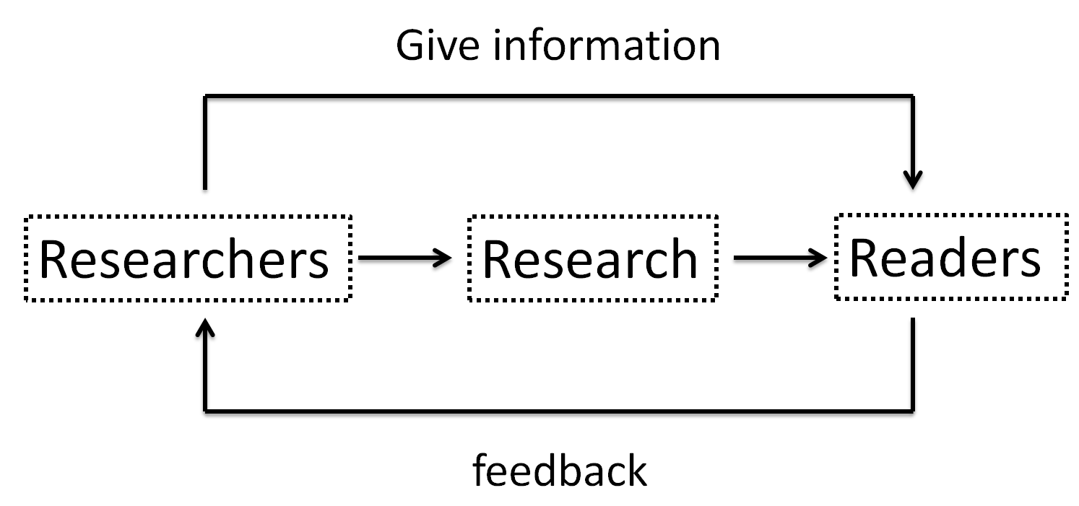
Summary
漫漫國際路
1991至今
做到美國第一
1981~1990

Slide 5
CH1 Thinking in Print
The uses of research, public and private

Slide 6
Research
漫漫國際路
1991至今
做到美國第一
1981~1990
Who
When
Where
What
Why
How

Slide 7
1.1WHAT IS RESEARCH?
漫漫國際路
1991至今
做到美國第一
1981~1990
The research we do
Evaluate

Slide 8
Why we do research?
漫漫國際路
1991至今
Turn puzzle into question
Discover new question
The ability to judge
Solve a puzzle and discover that no one else knows
做到美國第一
1981~1990

Slide 9
1.2WHY WRITE IT UP
How we do research?
漫漫國際路
1991至今
Listen more than you can speak
Write it up
Not only write it up, but use it
做到美國第一
1981~1990

Slide 10
1.3WHY A FORMAL REPORT
Can I write my research in my own way ?
If I write as you expect to me , I risk losing my identity?
漫漫國際路
1991至今
做到美國第一
1981~1990
-When you write for others , you demand more of yourself
than when you write for yourself alone.
-You will understand your own work better when you try to
anticipate your readers’ inevitable and critical question.

Slide 11
1.4WRITE IS THINKING
漫漫國際路
1991至今
Writing a research report is thinking with and for your readers
Thinking for others is more thoughtful than just about any other kind of thinking
做到美國第一
1981~1990

Slide 12
CH2 Connecting with Your Reader
(RE-)CREATING YOURSELF AND YOUR READERS

Slide 13
Role
Every time you go to a written source for informatiom,
you join a conversation between writers and readers that began more than five thousand years ago.
漫漫國際路
1991至今
做到美國第一
1981~1990

Slide 14
2.1 CREATING ROLES FOR YOURSELF AND YOUR READERS
All conversations are social activities in which we are expected play our parts.
In face-to-face conversations
In an imagined conversation in writing
漫漫國際路
1991至今
做到美國第一
1981~1990

Slide 15
Example
The writers of these next two passages imagined different readers,
with different questions based on different levels of knowledge about the chemistry of heart muscles.
Case(a) & Case(b)
漫漫國際路
1991至今
做到美國第一
1981~1990

Slide 16



a
Writer and readers as colleagues.
Writer is an expert, but reader who know little.
b
Writer and readers as colleagues .
漫漫國際路
1991至今
做到美國第一
1981~1990
Writer is an expert, but reader who know little.
If they judged their readers correctly,
their readers will judge them favorably.

Slide 17
2.2 UNDERSTANDING YOUR ROLE
Beginners myth?
Switch the role of student and teacher.
漫漫國際路
1991至今
做到美國第一
1981~1990

Slide 18
Research relationship.
(the third is most common in academic research.)
I’ve Found Some New and Interesting Information
Interest to enhance the quality of learning.
I’ve Found a Solution to an Important Practical Problem
Help you do something to solve a problems.
Real world.
Your role.
Conceptual problem →Real world
I’ve Found an Answer to an Important Question
Conceptual problem
漫漫國際路
1991至今
做到美國第一
1981~1990

Slide 19
2.3 IMAGINING YOUR READER’S ROLE
Consider your audience.
You do your job, I also will do mine.
漫漫國際路
1991至今
I have information for you
I can help you fix a problem
I can help you understand something better
做到美國第一
1981~1990

Slide 20
Entertain Me.
Help Me Solve My Practical Problem.
Help Me Understand Something Better.
漫漫國際路
1991至今
Use something readers do not know and interesting thing to let readers pleasure
做到美國第一
1981~1990
Help them solve a practical problem ,they want to get the details right.
they expect your evidence is objective and rigorously logical

Slide 21
Conclusion
Concern with your particular community of readers, with their interests and expectations.
漫漫國際路
1991至今
做到美國第一
1981~1990
who
where
The way you report

Slide 22
Q&A

Slide 23

漫漫國際路
1991至今
做到美國第一
1981~1990
1.How to distinguish your audience’s role?

Slide 24

漫漫國際路
1991至今
做到美國第一
1981~1990
2.How much can I expect them to know already?

Slide 25

漫漫國際路
1991至今
3.It is knowledge explosion age now.
How can you get your data and information? Is it from internet, library or publish paper?
Which one is more trusted?
做到美國第一
1981~1990

Slide 26


