Slide 1
The American Occupation
Brett T. Kirwan 孔博仁
Japanese Politics
5 March 2013

Slide 2
Outline
Timeline
Framework
Goals
Characteristics
The Emperor
Initial Measures
War Crimes
Phase 2
Four Major Reforms
1947 Constitution
US in Japan Today
Conclusion
Discussion

Slide 3
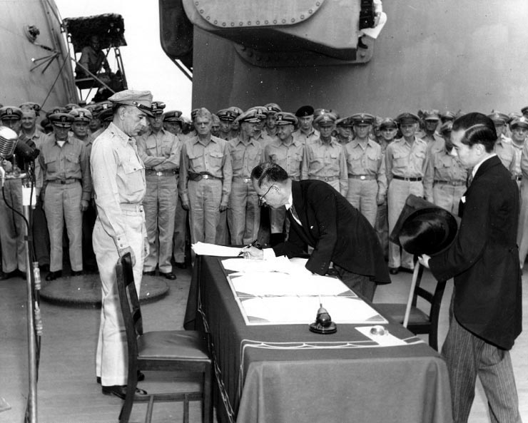
Timeline
Japanese surrender
  14 Aug 1945
  2 Sep 1945
Occupation
  28 Aug 1945 –
  28 Apr 1952
  Phase 1: 1945 – 1947
  Phase 2: 1947 – 1952
Japanese Foreign Minister Shigemitsu signs the Instrument of Surrender onboard USS Missouri, 2 Sep 1945

Slide 4
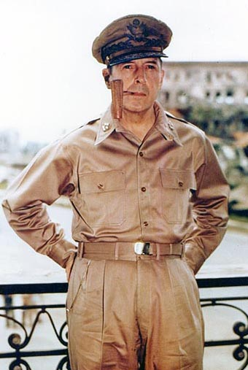
Framework
Partition
  Colonies divided, but not
  mainland
Leadership
  Officially, Far Eastern
  Commission and Allied
  Council for Japan
  Almost exclusively
  American-directed
  General Douglas MacArthur, SCAP

Slide 5
Goals
Eliminate Japan’s war-making power
  Sovereignty as outlined by Potsdam Declaration
  Disarmament; decrease military’s role
Democratize along American lines
  Liberty, human rights
  (Peaceful) economic development
US Initial Post-Surrender Policy for Japan
  6 Sep 1945

Slide 6
Characteristics
MacArthur
  Moderate left sensibilities, New Deal
  Christian
  Independent
Urgency
  Apr 1946 elections
Lack of experience
Cooperation
Hardship for the Japanese

Slide 7
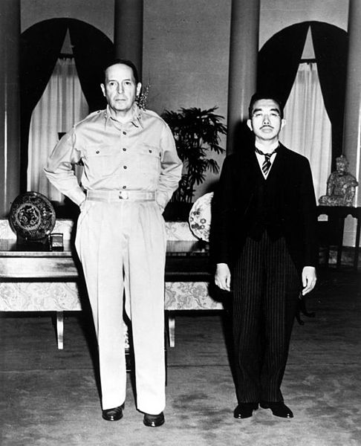
The Emperor
Disagreement about
royal family’s future role
  Emperor and entire family
  absolved of responsibility
  for war
Retained as constitutional
monarch
  Little political power
  Important symbol for people
  Cooperated with US
Gen. MacArthur and Emperor Hirohito, 17 Sep 1945

Slide 8
Initial Measures
Demobilization
Dismantling of empire
End to state sponsorship of Shinto
Emancipation of women
Release of political prisoners
Decentralization of police
Reform of bureaucracy
Economic rebuilding

Slide 9
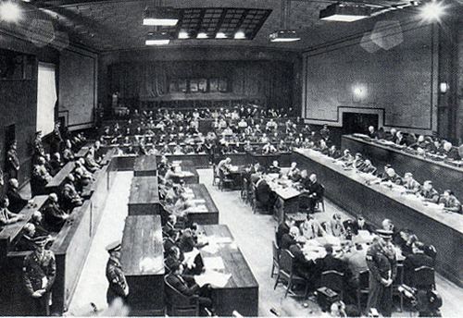
War Crimes
International Military Tribunal for the Far East
  29 Apr 1946 –
  12 Nov 1948
  28 Class A criminals
    7 hanged
  5,700 Class B and C
    Nearly 1,000 executed
220,000 barred from future office
  Including 180,000 military officers

Slide 10
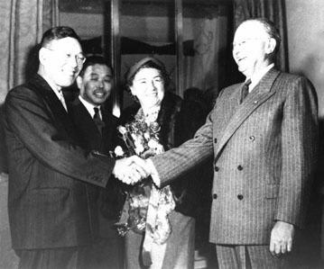
Phase 2
Reverse Course
Concern over political left replaced concern over militarism
  Driven by Cold War,
  Chinese Communist victory,
  Korean War
  Also influenced by US
  business interests
    Dodge Plan
    MITI created, 1949
Hayato Ikeda and Joseph Dodge, 1948

Slide 11
Land
“Most successful reform by SCAP”
Purchased land, resold to tenant farmers
  38% of Japan’s cultivated land
  46% tenant-farmed → 90% land-owning farmers
  Rent control

Slide 12
Labor
Labor embraced goals of occupation
Occupation initially encouraged unions
  Guaranteed freedom of association
  1946, Trade Union Act, Labor Relations Act
  1947, Labor Standards Act
Ultimately too successful
  Seen as militant, supporting political left
  Industry-wide unions discouraged
  Suffered during Phase 2 of occupation

Slide 13
Zaibatsu
Initial plan to break up family clans
Largely a failure
  Resistance and delay from government and business community
  By 1948, change of direction from US
Replaced by keiretsu

Slide 14
Education
Sought to instill democratic values, decrease rigidity, increase opportunity
1947, Basic Law on Education, School Education Law
Introduced US education methods
  Banned teaching of Shinto, authoritarianism
Impact faded following occupation

Slide 15
1947 Constitution
Presented as continuation of Meiji Constitution
Reflected US political philosophy, New Deal
Based on popular sovereignty; reduced role of emperor
Renounces war (Article 9)
Enshrines civil rights (Chapter III)
Parliamentary system
Not yet amended

Slide 16
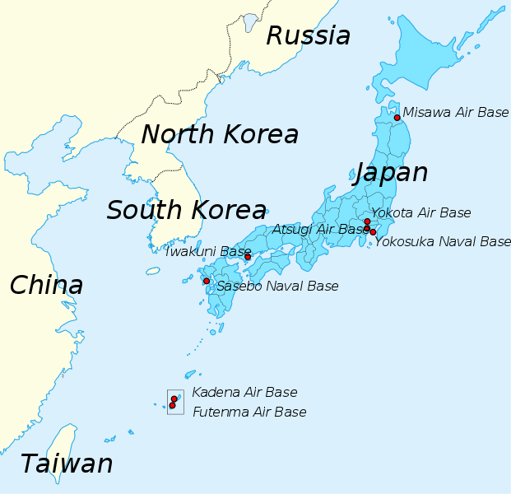
US in Japan Today
38,000 military personnel
43,000 dependents
5,000 DoD civilians

Slide 17
Conclusion
Great success of US foreign policy
Many lasting effects, but not all
“Pass through” of elites, power structures

Slide 18
Discussion
Based on its goals of demilitarization and democratization, how successful was the occupation?
Did more aspects of Japan change or stay the same?
Is Japan abiding by Article 9 today?

