Slide 1
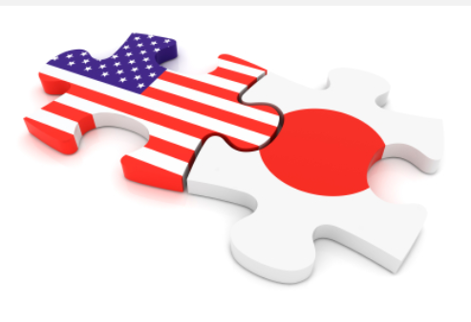
The Rationales for the U.S. and Japan
Professor Yujen Kuo
Student Yang-Ho Chang

Slide 2

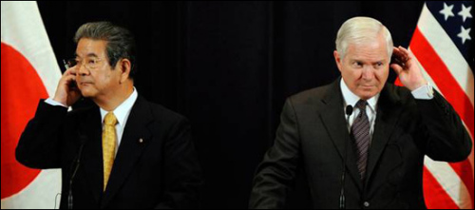
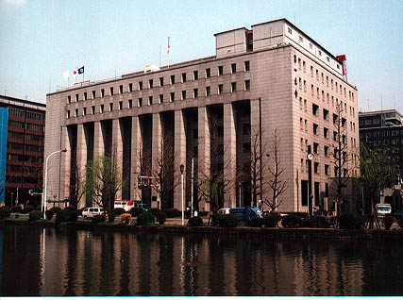
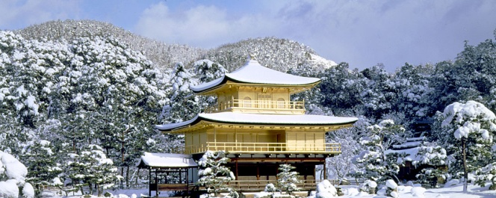
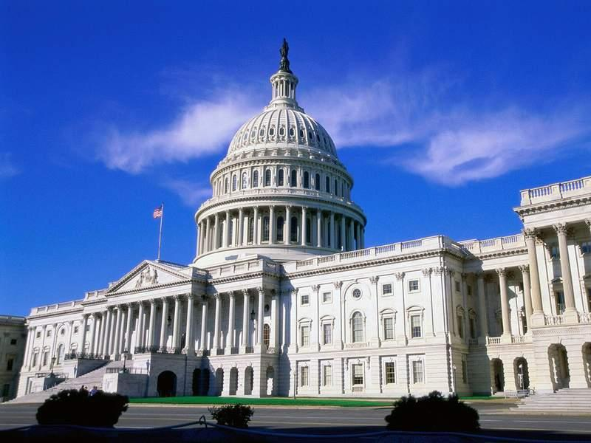

Contents
1
Summary
2
Comparison analysis
3
Fundamental knowledge of alliance theory
4
Case Studies and Perspectives in Japan
5
Q&A

Slide 3
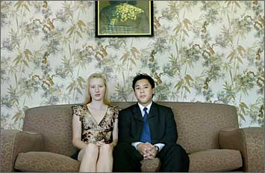
Summary
One word to conclude these two chapters:
  Swap
Japan does not do enough.
United States always seems to want too much, too soon.

Slide 4
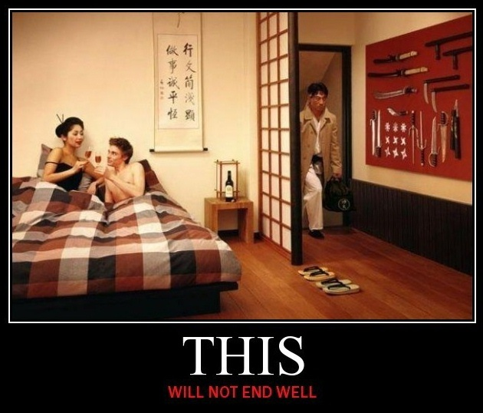
Summary
One sentence to conclude these two chapters:
  A changing nature of the alliance.

Slide 5


The Overall Picture
Japan:
  A primary component in the US’s global military positioning
  Japan maintains to be the lynchpin for US military operations in the Asia-Pacific as well as West and Central Asia
  Politically and economically, however, Japan’s standing vis-à-vis the US is on the decline although it is still a major partner
United States:
  US military presence is perceived as the centerpiece of Japan’s regional security
  Leading economic and political partner for Japan
  Every president since the end of World War II has recognized that maintaining a strong security alliance with Japan is in the vital interest of the United States

Slide 6
Comparison
 | Tomohito Shinoda (Costs and Benefits of the U.S.-Japan Alliance from the Japanese Perspective) | Michael Mastanduno (Global Costs and Benefits of the U.S.-Japan Alliance: An American View)
The U.S.-Japan alliance remains the best option for both countries | Limited assurance | Positive assurance
Sources of the polls which are supporting these articles: | Cabinet Office poll (2009) | Joint Yomiuri-Gallup poll (2009)
Most of the forms of the costs and benefits: | Tangible (70%) Intangible (30%) | Tangible (10%) Intangible (90%)
Starting point for thinking: | The “Japan as a starting point” perspective | The "multi-position as a starting point" perspective
Author
Distinguishing Factors
Aircraft such as the F-86, F-4 and F-15. Missiles such as the Sparrow, Hawk and Patriot. Long-term loans from the World Bank. Social infrastructures such as Shinkansen. Middle East oil. Export industrial goods. Cost of US bases in Japan.
National sentiment. Autonomy. Rise of China. Shifts in Japanese domestic politics. War on terrorism. Role in regional security. US foreign policy. Nuclear umbrella. International concerns.

Slide 7
US-Japan Security Framework in the Asia-Pacific: Theoretical Approaches from Japan’s perspective | US | Japan | China | Possible outcome
Realist Approach (Acting on self interest according to global balance of power) | Decline in economic & political power | Two options: *Shifting away from the US and toward China *Keeping alliance with the US (and others) to counter-balance China | A center of gravity in the region for Japan to seek closer cooperation | *US-Japan security alliance becomes secondary to US-China and Japan-China relations *US-Japan alliance remains to be strong
Liberalist Approach (Economic interdependence & Institutions – From competition to cooperation) | Security centered approach towards East Asia becomes obsolete & anachronistic | East Asian Community and liberalization – binding China into the system | Integration into the global liberal system & democratization | Possible tension in US-Japan relations as Japan seeks a balance between its security relationship with the US and community relationship with the region
Constructivist Approach (Elite believes & interaction and public opinion matter in policy making) | Public opinion: Sympathy towards Japan and suspicion of China Elites: Realist-liberal | Public: Antipathy towards China Elites: Realist-Liberal | Public: Antipathy towards Japan Elites: Hyper-realist | Preservation of the status quo
“…Yoshida was a pragmatic political leader, and well recognized that the only possible way for an early end of the occupation was to conclude a security treaty with the United States. …”
2. “…The DPJ wanted to restrict the SDF dispatches overseas and do so only at the request of the UN Security Council. …”
3. “…The DPJ demanded revision of the Status of Forces Agreement in regard to the treatment of U.S. servicemen who commit a crime in Japan. The party would like to equip Japan with the primary right of trial even for their on-duty acts, and pre-indictment custody of the accused service members. …”

Slide 8
US-Japan Security Framework in the Asia-Pacific: Theoretical Approaches from Japan’s perspective | US | Japan | China | Possible outcome
Realist Approach (Acting on self interest according to global balance of power) | Decline in economic & political power | Two options: *Shifting away from the US and toward China *Keeping alliance with the US (and others) to counter-balance China | A center of gravity in the region for Japan to seek closer cooperation | *US-Japan security alliance becomes secondary to US-China and Japan-China relations *US-Japan alliance remains to be strong
Liberalist Approach (Economic interdependence & Institutions – From competition to cooperation) | Security centered approach towards East Asia becomes obsolete & anachronistic | East Asian Community and liberalization – binding China into the system | Integration into the global liberal system & democratization | Possible tension in US-Japan relations as Japan seeks a balance between its security relationship with the US and community relationship with the region
Constructivist Approach (Elite believes & interaction and public opinion matter in policy making) | Public opinion: Sympathy towards Japan and suspicion of China Elites: Realist-liberal | Public: Antipathy towards China Elites: Realist-Liberal | Public: Antipathy towards Japan Elites: Hyper-realist | Preservation of the status quo
“… The logic of U.S. hedging strategy is to hold out the carrot of economic cooperation and integration as a reward for what the U.S. considers “responsible stakeholder” behavior, but also to make China aware that revisionist behavior could result in a costly security competition with the United States and its partners. …”

Slide 9
US-Japan Security Framework in the Asia-Pacific: Theoretical Approaches from Japan’s perspective | US | Japan | China | Possible outcome
Realist Approach (Acting on self interest according to global balance of power) | Decline in economic & political power | Two options: *Shifting away from the US and toward China *Keeping alliance with the US (and others) to counter-balance China | A center of gravity in the region for Japan to seek closer cooperation | *US-Japan security alliance becomes secondary to US-China and Japan-China relations *US-Japan alliance remains to be strong
Liberalist Approach (Economic interdependence & Institutions – From competition to cooperation) | Security centered approach towards East Asia becomes obsolete & anachronistic | East Asian Community and liberalization – binding China into the system | Integration into the global liberal system & democratization | Possible tension in US-Japan relations as Japan seeks a balance between its security relationship with the US and community relationship with the region
Constructivist Approach (Elite believes & interaction and public opinion matter in policy making) | Public opinion: Sympathy towards Japan and suspicion of China Elites: Realist-liberal | Public: Antipathy towards China Elites: Realist-Liberal | Public: Antipathy towards Japan Elites: Hyper-realist | Preservation of the status quo

Slide 10

Japan’s Dilemma
Abandonment: Too much desire for autonomy might result in abandonment by the leading power
Entrapment: Losing control of its own interests and military assets by relying too much on the leading power

Slide 11
Alliance Theory: Abandonment
Example 1-1
C
New relationship
US-Japan alliance
A
J

Slide 12
Alliance Theory: Abandonment
Example 1-2
C
US-China alliance
A
J

Slide 13
Alliance Theory: Abandonment
Example 2-1
C
New relationship
US-Japan alliance
A
J
Old relationship

Slide 14
Alliance Theory: Abandonment
Example 2-2
C
New relationship
A
J
Old relationship
De-aligning into a neutral position

Slide 15
Alliance Theory: Entrapment
Example 3-1
I
Fight with J
Fight with I
Fight back
US-Japan alliance
A
J

Slide 16
Japanese Perspective
A more robust SDF would decrease the possibility of abandonment by raising the utility of the alliance to the United States. At the same time, enhanced indigenous capabilities would reduce the likelihood of entrapment by providing Japan with a more credible exit option.
Tokyo’s fears of abandonment overshadowed those of entrapment in the aftermath of September 11. Although not grounds for alliance termination, Japanese inaction might have increased the possibility of limited forms of abandonment.

Slide 17
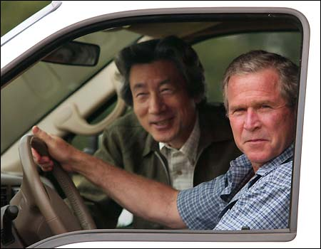
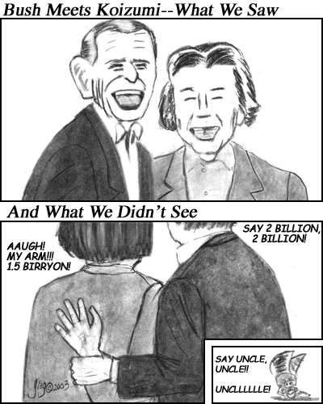
Japanese Perspective
Unlike September 11, the Iraq War can be classified as a case of entrapment.
Alliance theory would suggest that to avoid entrapment, Tokyo should have distanced itself from Washington’s position on Iraq.
Deploying the SDF to postwar Iraq represented a literal form of entrapment. Yet Tokyo contributed troops, even though the abandonment costs of doing otherwise would have been relative low.

Slide 18
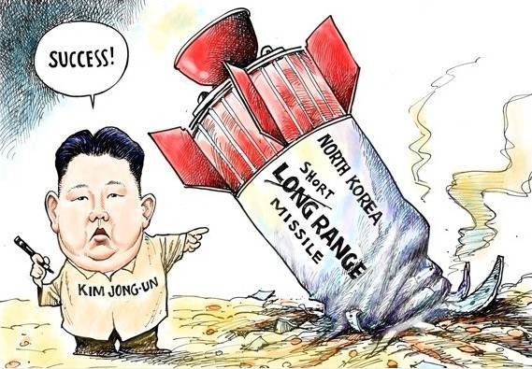
Q&A
Q: In the case of North Korea, entrapment concerns ─ a U.S. preemptive attack ─ should outweigh fear of abandonment. Is Tokyo’s decision to deploy ballistic missile defense a means of avoiding entrapment？
A: Not necessarily. Missile defense minimizes the damage associated with entrapment ─ North Korean retaliation ─ rather than lowering the risk of a U.S. preemptive strike altogether. Once deployed, ballistic missile defense might even encourage the United States to use force because Japan Would (arguably) be invulnerable from North Korean retribution. Again, alliance theory fails to explain Japan’s recent security behavior.

Slide 19
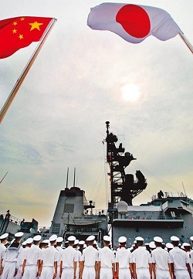
Q&A
Q: Yukio Hatoyama stated that the U.S.-led era of globalism was coming to an end and asked how Japan could protect its national interest when caught between a United States struggling to maintain its dominance and a China seeking to attain dominance？
A: His answer was that Japan needed to help forge an East Asian political and economic community. East Asia “must be recognized as Japan’s basic sphere of being,” and “we must not forget our identity as a nation located in Asia.”
How about you, do you agree with that ？

