Slide 1
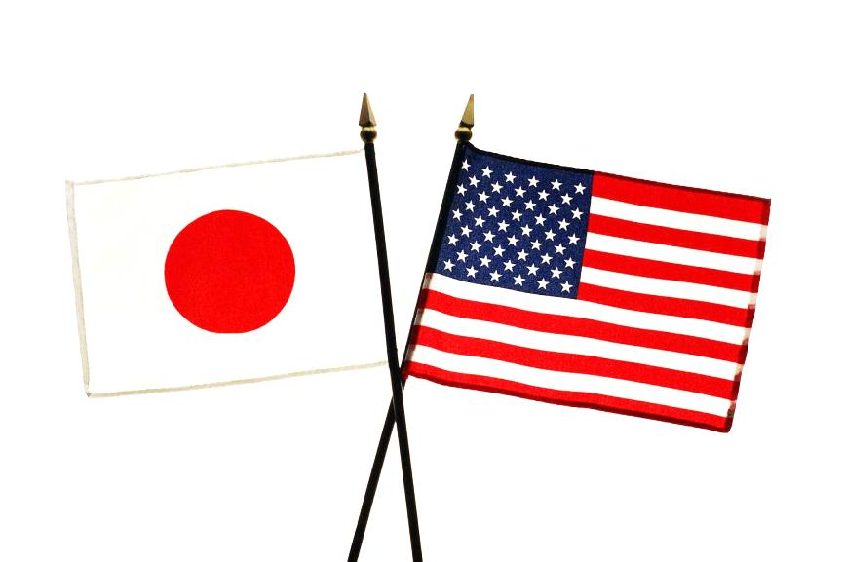
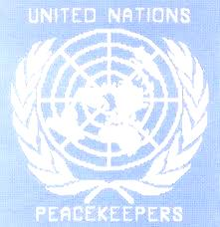
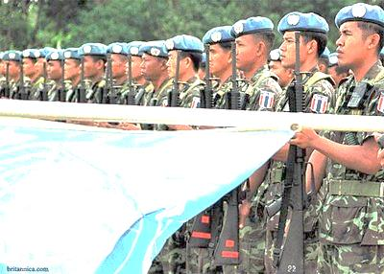
U.S.-Japan Relations and Military Alliance
- Peacekeeping and the U.S.-Japan Alliance -
Takashi Inoguchi and G.John Ikenberry, eds. 2003. Reinventing the Alliance: U.S.-Japan Security Partnership in an Era of Change. New York: Palgrace MacMillan
Sarah Windmüller
M006070033

Slide 2

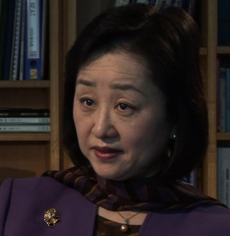
Authors
Stephen John Stedman, „Peacekeeping and the U.S.-Japan Alliance“
Leading expert on civil wars and conflict management
Former research director of the United Nations High-level Panel on Threats, Challenges and Change (2003-2004), and assistant secretary general and special advisor to the secretary general of the United Nations (2005)
Akiko Fukushima, „UN Peacekeeping Operations and Japan‘s Role in Retrospect and Prospect: A Possible U.S.-Japan Cooperation“
Former Research Fellow at Aoyama Gakuin University, Tokyo, Adjunct Professor of the Law School at Keio University, and Visiting Professor at the University of British Columbia Canada
Director of Policy Studies at the National Institute for Research Advancement (NIRA), Senior Fellow at the Japan Foundation

Slide 3
Agenda
Evolution of UN Peace Operations
Aspects of Post-1989 Missions
U.S. versus Japanese Positions towards PKO
Japan‘s Constraints towards PKO
Demand for Peace Operations in Asia
Possible U.S.-Japan Cooperation within the Alliance

Slide 4
Summary
Japan is not ready yet!

Slide 5
Evolution of UN Peace Operations
Born put of necessity, it was an ad hoc response to international crises, where it was believed that the interposition of a military force could create a buffer between warring parties and lessen military insecurities of both sides
Before 1989
Gradual evolution of peacekeeping concepts, demands, techniques
Continuity of participating countries that trained their troops in the tasks of peacekeeping
After 1989
UNTAG (United Nations Transition Assistance Group): interject peacekeeping troops into civil conflicts, demobilization of soldiers, voter registration and education, election assistance and monitoring
ONUCA (UN Observer Group in Central America): supervise external supply of weapons to internal factions, help disarm one faction, observe elections

Slide 6
Aspects of Post-1989 Missions
Nonmilitary = Implementation of detailed peace agreements requires nonmilitary functions, such as:
Verification, supervision and conduct of elections
Supervision of civil administration
Promotion and protection of human rights
Supervision of law and order/police activities
Economic rehabilitation
Repatriation of refugees
Humanitarian relief
De-mining assistance
Public information activities
Training and advice to governmental officials

Slide 7
Aspects of Post-1989 Missions
Military
Assist parties to demobilize and disarm
Enforce sanctions and no-fly zones
Protect safe areas
Deliver humanitarian aid
→ Call for different expertise, therefore multiplying force requirements and placing greater demands on command, control, coordination and communications

Slide 8
U.S. versus Japanese Positions towards PKO
Background
Somalia in the 1990s: UN intervened without the consent of the warring parties and therefore found itself under attack from the armed faction
Overconfidence in the ability of the UN
United States | Japan
Historically: ambivalence toward international organizations and their activities | Historically: constitutional limitations on deployment of troops/weapons abroad
Clinton: congressional opposition + restrictive participation in UN missions | Issue of peacekeeping = desired identity as a Great Power
Bush: Before 9/11: deeply critical, unsupportive After 9/11: necessity for UN peace operations, request for allied participation | After 9/11: provision of financial support and humanitarian assistance, no SDF support

Slide 9
Japan‘s Constraints towards PKO (1)
Underlying tension between Japan‘s general support for the UN, and its deep-seated reluctance to use military force after WWII
Historical legacy: neighboring countries‘ concerns about Japan‘s initiatives in the field of security
Pacificst orientation: strong public support for Article 9 of Japan‘s constitution
(Aspiring sincerely to an international peace based on justice and order, the Japanese people forever renounce war as a sovereign right of the nation and the threat or use of force as means of settling international disputes.
To accomplish the aim of the preceding paragraph, land, sea, and air forces, as well as other war potential, will never be maintained. The right of belligerency of the state will not be recognized.)
→ Domestic debate, on whether Japan should send its forces to UNPKO or not

Slide 10
Japan‘s Constraints towards PKO (2)
How did Japan try to solve this problem?
Application for UN membership, 1952: due to constraints of Article 9 of the National Constitution, Japan would not be able to participate in the collective security mechanisms provided for in the UN Charter
Japan was not obliged to do what was behind its means
Participation in PKO has been limited, and mainly restricted to:
Financial and equipment support
Election monitoring
Medical activities
Communication and transportation activities
Civilian police and patrol activities
Logistical support

Slide 11
Japan‘s Constraints towards PKO (3)
Free-rider criticisms from overseas
Desire to play significant role not only in global economic affairs but also in international politics

Slide 12
Japan‘s Constraints towards PKO (4)
UN‘s PKO principles | Japan‘s PKO principles
Existence of cease-fire agreement | Cease-fire must be in place between the warring parties
Impartiality and non-intervention | Parties to the conflict and host country must have given their consent to the operation, and Japan‘s participation in it
Non-coercion | Operation must be conducted in a strictly impartial manner
Use of weapons only in cases of self-defense | Japan‘s participation may be suspended and personnel/troops withdrawn, if any of the mentioned conditions cease to be met
Maintenance of the international character of the operation | Use of weapons shall be limited to the minimum necessary to protect the lives of the personnel

Slide 13
Japan‘s Constraints towards PKO (5)
International Peace Cooperation Law (1992)
Provided legal framework that enabled Japanese personnel, including SDF units, to participate in PKO
De-freezing of PKO core activities occured without constitutional revision
  Deployment of SDF units stayed restricted to areas where the probability of hostility was low
5 principles ensured that Japanese personnel would not be identified with the use of force
  Need to consider revising the International Peace Cooperation Law so that consent for Japan‘s participation in a PKO will be the same as the consent the UN obtains for conducting operations

Slide 14
Demand for Peace Operations in Asia
Background
Asia suffered from more violent conflicts in the 1990s than any other continent
  Today peacekeeping may become important in the area of antiterrorist missions, e.g. Philippines
Comparatively few UN interventions in the region
Why?
Conceptions of sovereignty: belief of Asian states that UN mediation or intervention in their country would undermine their sovereignty
→ Need for fundametal rethinking of sovereignty, and embed such rethinking in a regional multilateral framework

Slide 15
Possible U.S.-Japan Cooperation within the Alliance
Exploring new forms of cooperation in the 21st century
Bilateral joint activities
  Peace building, e.g. joint training of peacekeepers
  Conflict prevention, e.g. civilian police activities in post-conflict areas, to maintain community security and safety
Gradually include other countries and develop a multilateral humanitarian assistance and peacekeeping mechanism in the Asia-Pacific
Regional mechanism for legitimizing intervention in an intra-state conflict when the UN cannot adopt a resolution

Slide 16
Q&A
Can and should peace operations be an integral part of the U.S.-Japan alliance? If yes, how could such joint operations look like (considering Japan‘s constraints towards PKO)?

