Slide 1

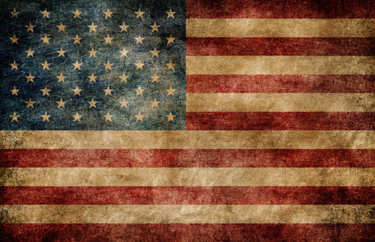
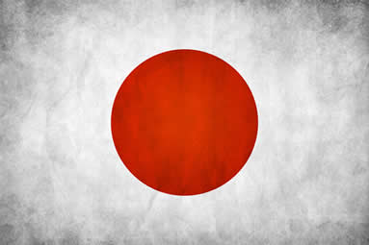
Future CHALLENGES
Carletti Sylvain – M014610038

Slide 2
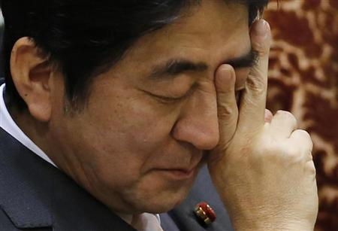
Sentence of the day
Uncharted territories ahead, there isn’t a blueprint that can really facilitate Japanese situation and help it evolve toward the right direction with ease
!!GOOD LUCK!!

Slide 3
Background
Globalization
Rise of a multipolar world
“Relative” decline of American superpower
Ongoing tensions in the region

Slide 4
Transition from Future cases
Negative factor for US
Negative factor for Japan
Leaning toward China without Japanese consultation(abandonment-changing environment)
Ignoring base issue sensitivity (domestic-Japan)
Encourage pro-constitutionalist
Inadequate contribution: prohibiting collective defense right and poor crisis management capability
Structural problems (mechanism for crisis in Japan)
Legal problems (current official interpretation of the Japanese constitution)
Anti-Us bases campaign, especially in Okinawa(domestic-Japan)
Security Free Rider

Slide 5
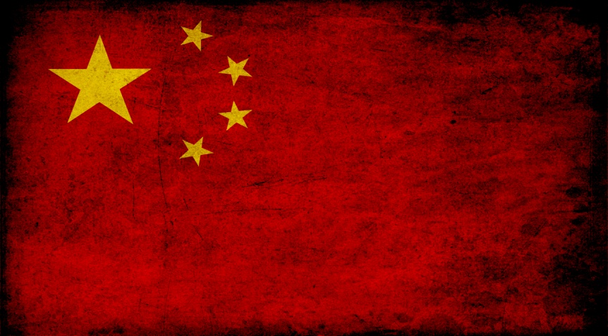
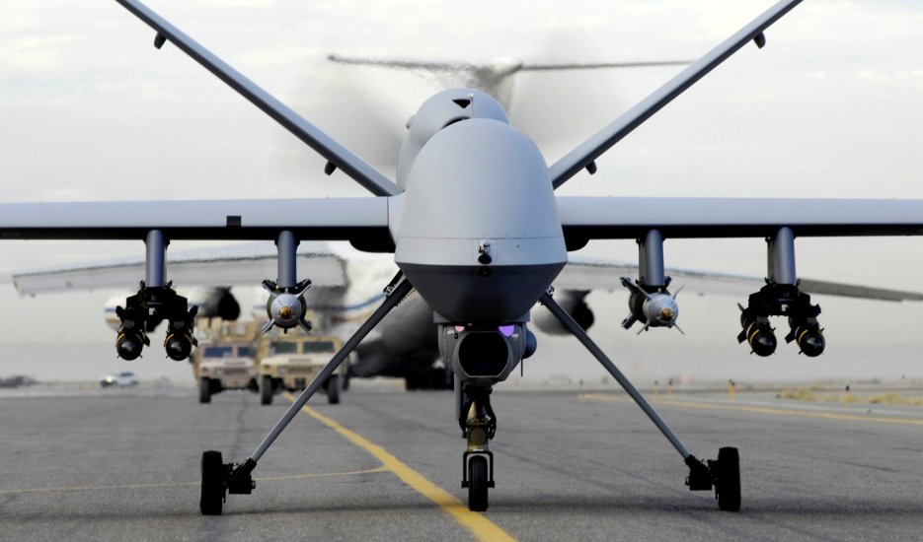
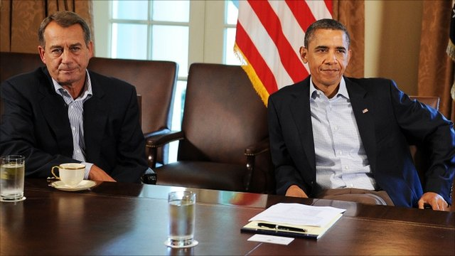
Influence on the future of US overseas presence
The changing security environment
The Changing nature of warfare
Changing domestic factors

Slide 6
Comparative studies
Chapter 7
The impact of Globalization on the alliance
Dulles San Francisco System collapse
Future opportunities
Chapter 8
Past alliances & relationship and possible conclusion which can be highlight for the Pacific alliance
Chapter 7 & 8

Slide 7
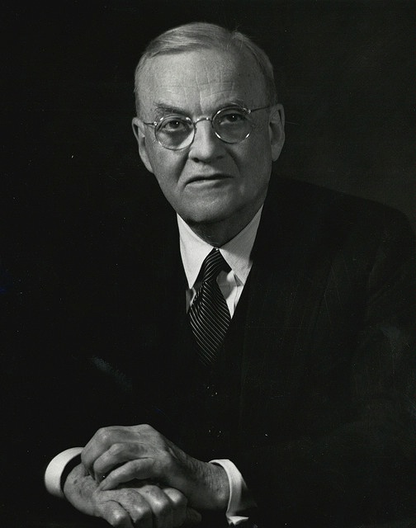
Chapter 7
The global challenge
San Francisco “System”
Historical evolution
Collapse
Misconceptions

Slide 8
Chapter 8 Alternative paradigms
Japan – UK naval alliance
US – UK alliance
Relevance
Difference
Conclusion
Relevance
Difference
conclusion

Slide 9
Chapter 8 Alternative paradigms
US – PRC relation
US – Germany partnership
Relevance
Differences
conclusion
Relevance
Differences
conclusion

Slide 10
Personal thoughts
conclusion

